Slide 1
Module 13: Implement Container-Based Applications
Azure Container Instances and Azure Kubernetes Service

Slide 2

Learning Objectives
You will learn the following concepts:
Configure Azure Kubernetes Service
Azure Kubernetes Service
Demonstration: Deploy Kubernetes with AKS
Azure Container Instances
Azure Container Instances
Demonstration: Run Azure Container Instances

Slide 3
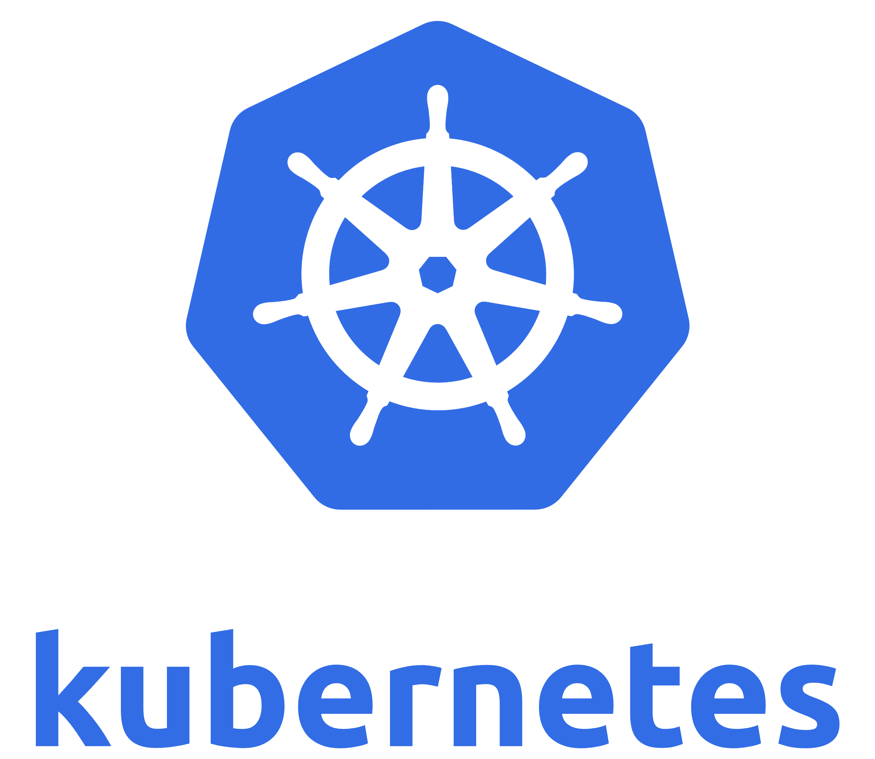
Configure Azure Kubernetes Service

Slide 4
Azure Kubernetes Service (AKS)
Deployment Center and Azure DevOps:
Automatically create Azure resources, such as an AKS cluster
Create an Azure Application Insights resource for monitoring an AKS cluster
Enable Azure Monitor for containers to monitor performance for the container workloads on an AKS cluster

Slide 5

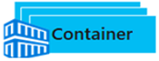
AKS Terminology
Pool
Term | Description
Pools
Nodes
Pods
Deployment
Manifest
Groups of nodes with identical configurations.
Node
Deployment (YAML)
Pod
Pod
Individual VM running containerized applications.
Single instance of an application. A pod can contain multiple containers.
One or more identical pods managed by Kubernetes​.
YAML file describing a deployment.
Node
Node
Notes:
Kubernetes core concepts for Azure Kubernetes Service (AKS) - https://docs.microsoft.com/en-us/azure/aks/concepts-clusters-workloads

Slide 6
Demonstration: Deploy Kubernetes with AKS

Slide 7
Azure Container Instances

Slide 8
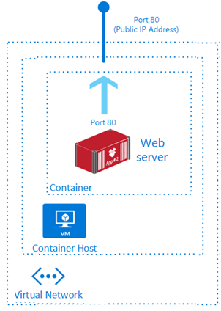
Azure Container Instances
PaaS Service
Fast startup times
Public IP connectivity and DNS name
Hypervisor-level security
Isolation features
Custom sizes
Persistent storage
Linux and Windows containers
Co-scheduled groups
Virtual network deployment
Fastest way to run a container in Azure without provisioning a VM

Slide 9




Container Groups
Top-level resource in Azure Container Instances.
A collection of containers that get scheduled on the same host.
The containers in the group share a lifecycle, resources, local network, and storage volumes.
Container Group
80
Container
Web
Azure Files
DNS Name & IP Address
1433
Container
Azure Files

Slide 10
Demonstration: Run Azure Container Instances
Create a container

Slide 11

Module 13 Review Questions

